Slide 1
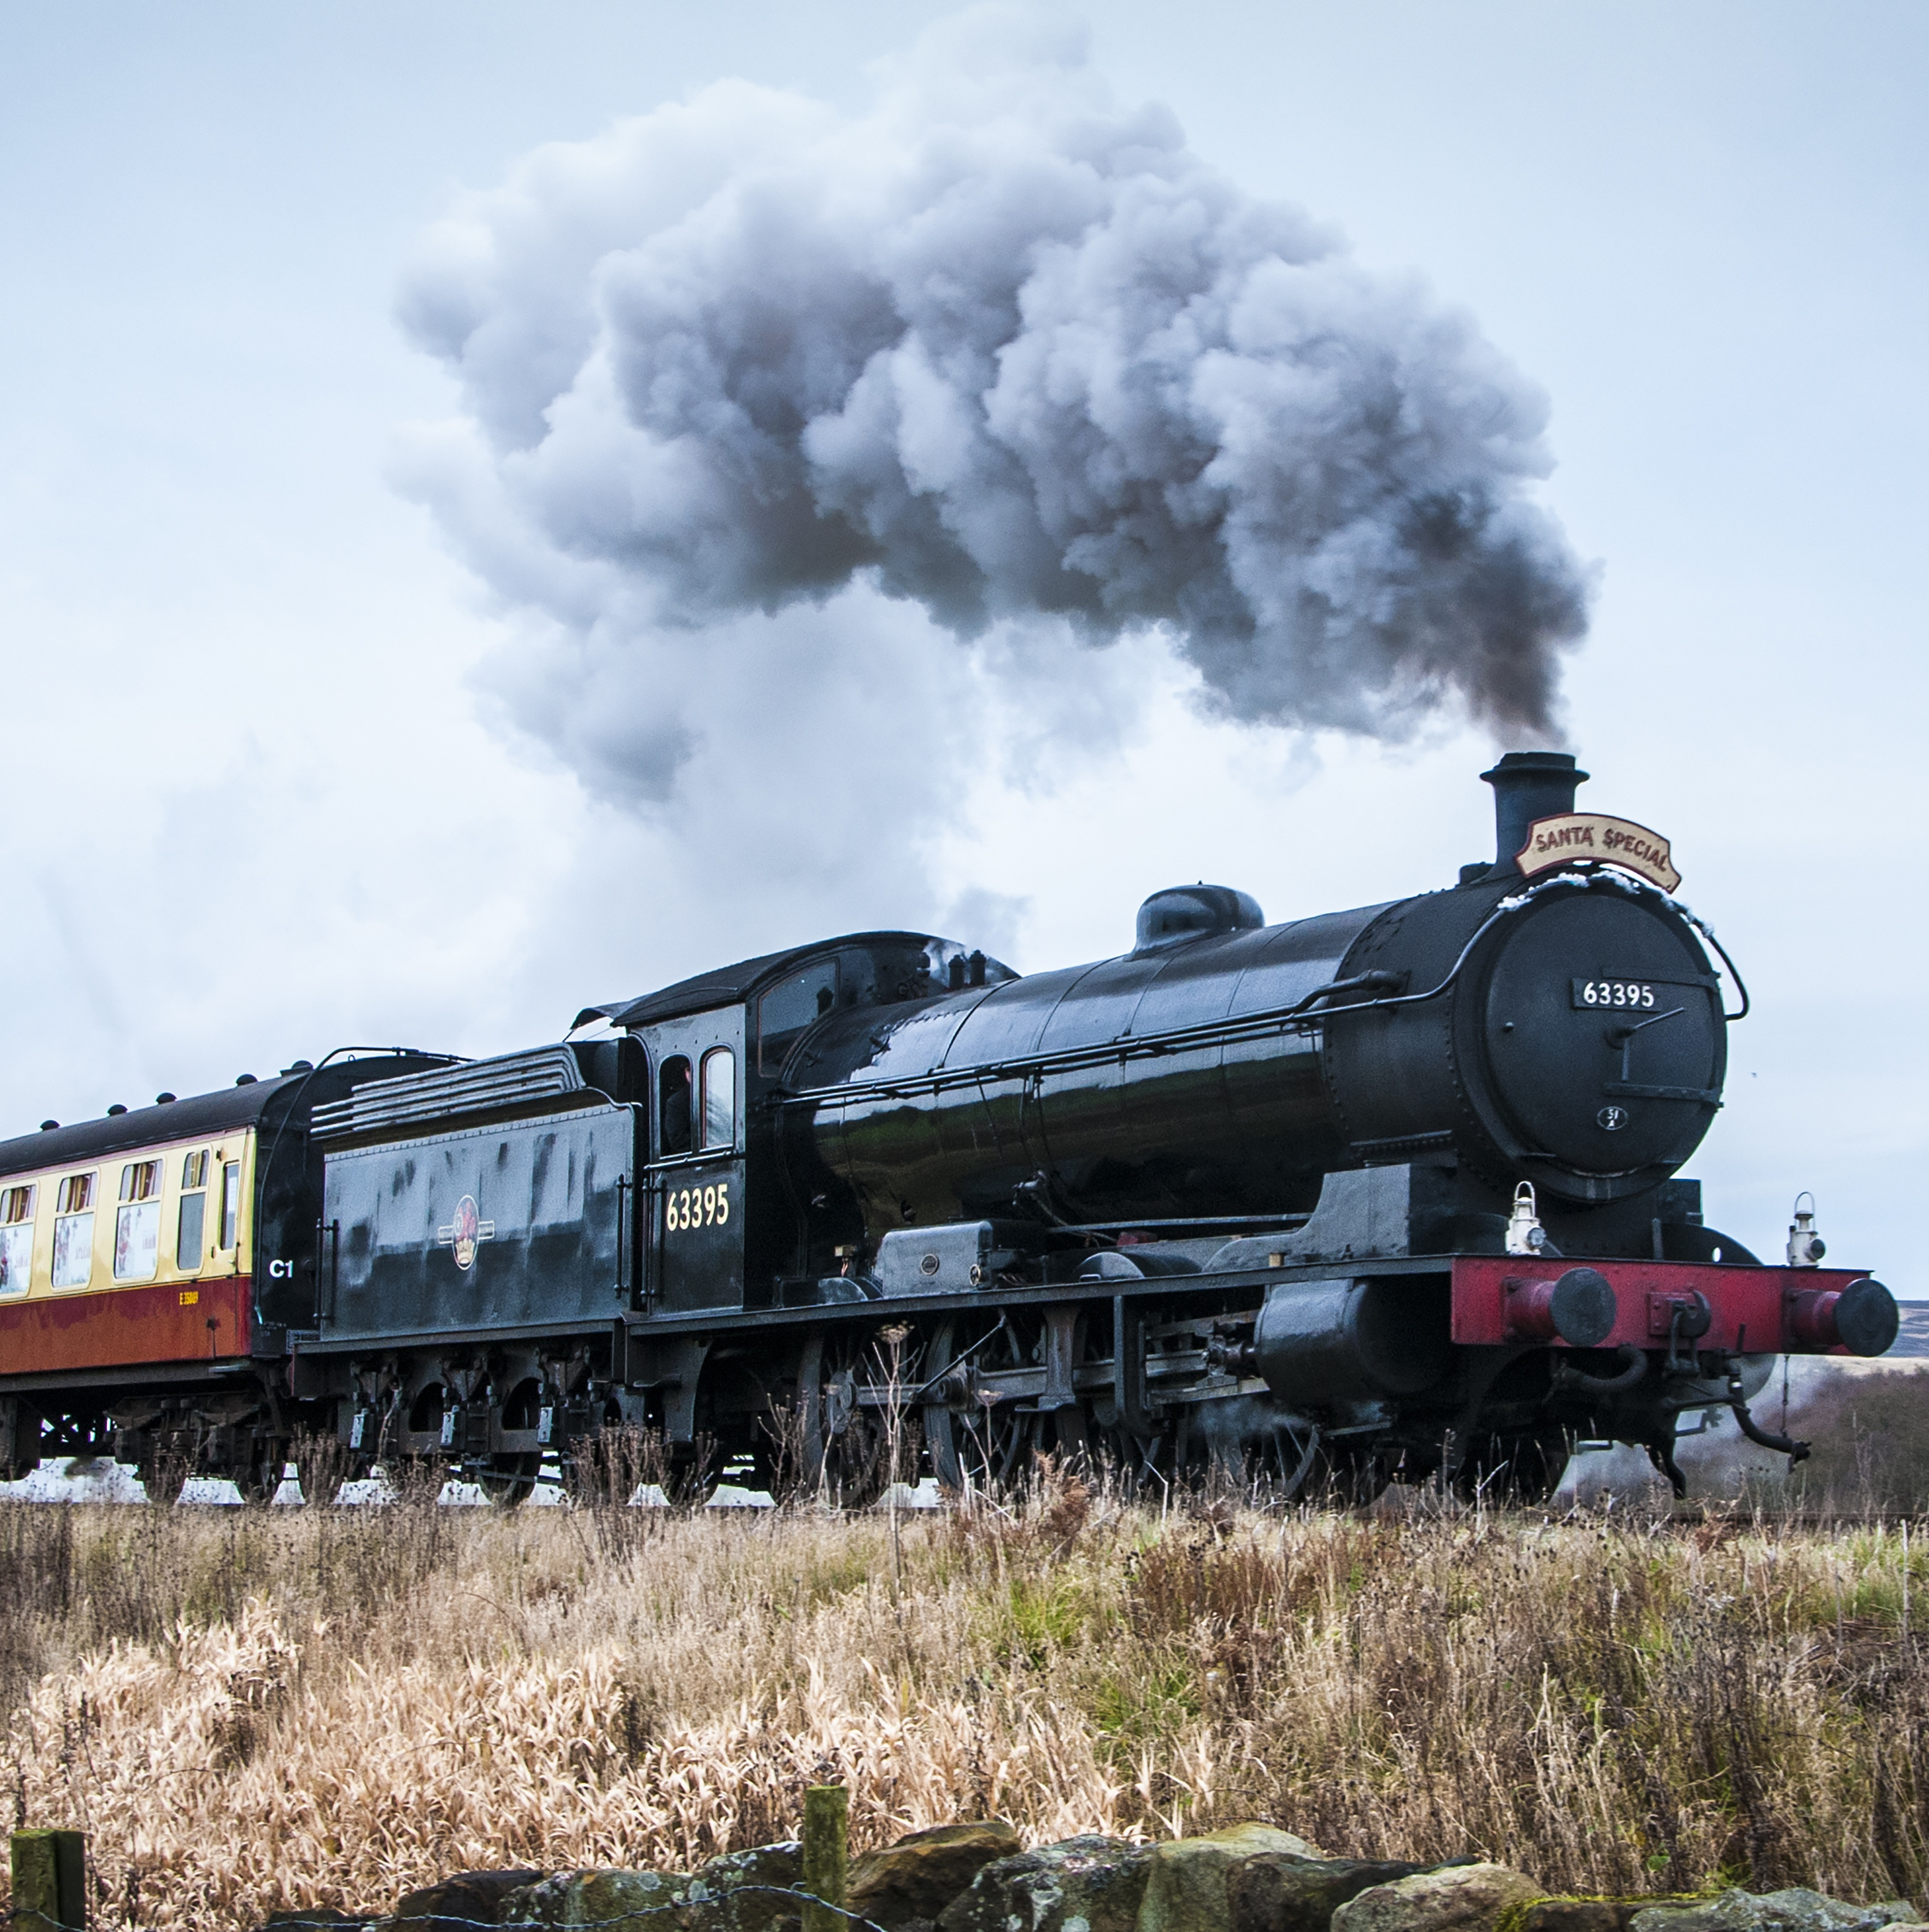
TRAIN TICKET RESERAVATION
Project by:
Bhagwati Tiwari -6140
Harsh Kumar -6172
Akshat Singhai -6157
Murali Arandala - 6145
Swapnil Deokar -6162

Slide 2
CONTENTS
Introduction
Problem Statement
Design/Architecture
Technologies Used
Screenshots

Slide 3

INTRODUCTION
This system is basically concerned with the reservation of Railway tickets to the passengers.
In this we are discussing that how reservation is done.
What are the rules & regulations and procedure for reservation.

Slide 4




Problem Statement
Create a train ticket reservation application using spring boot with java/MySQL/html/CSS/.
Where user can login and book the ticket.
Where Admin can Add/delete and Edit the Database.

Slide 5
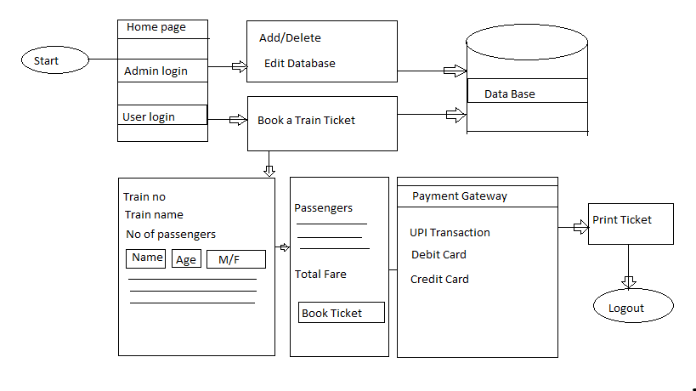
ARCHITECTURE / DESIGN

Slide 6

TECHNOLOGIES USED
Spring Boot
MySQL
Java
HTML
CSS
Java Script
Bootstrap

Slide 7
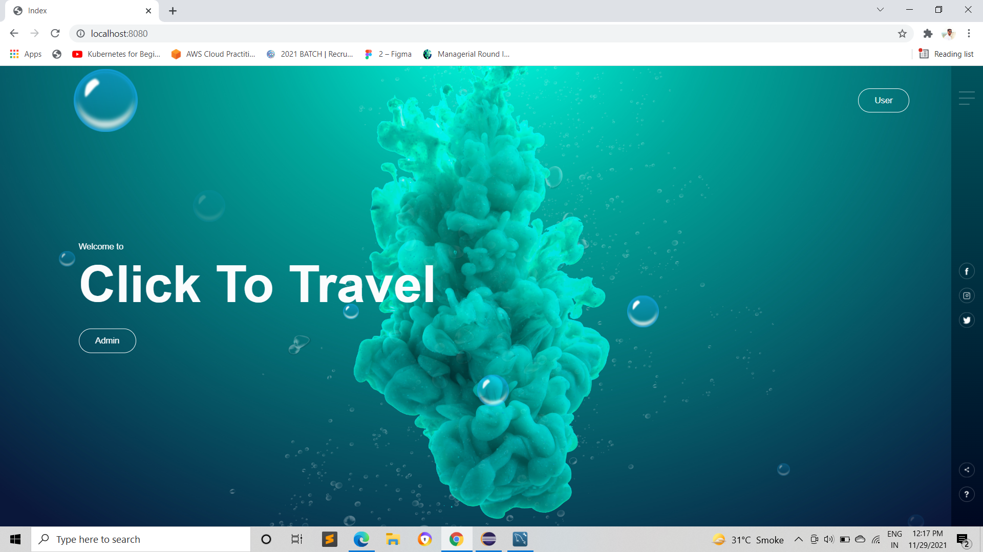

Slide 8
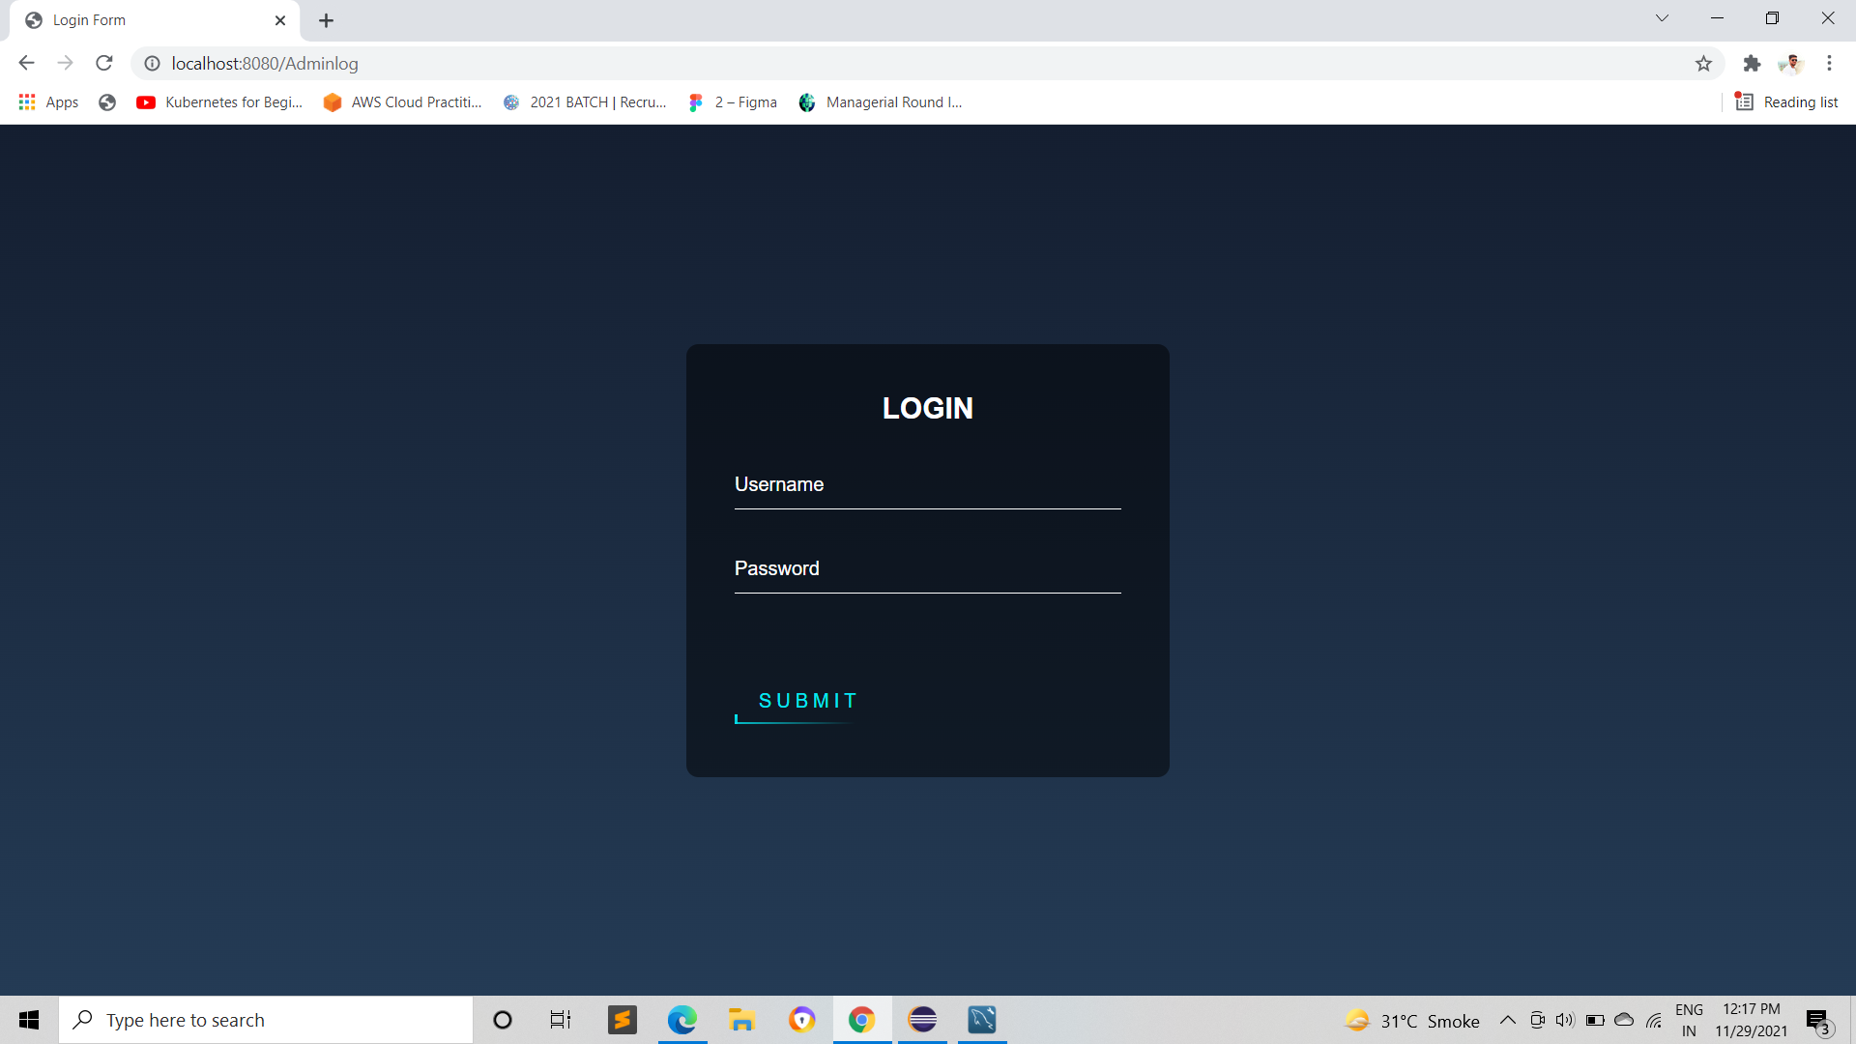
SCREENSHOTS

Slide 9
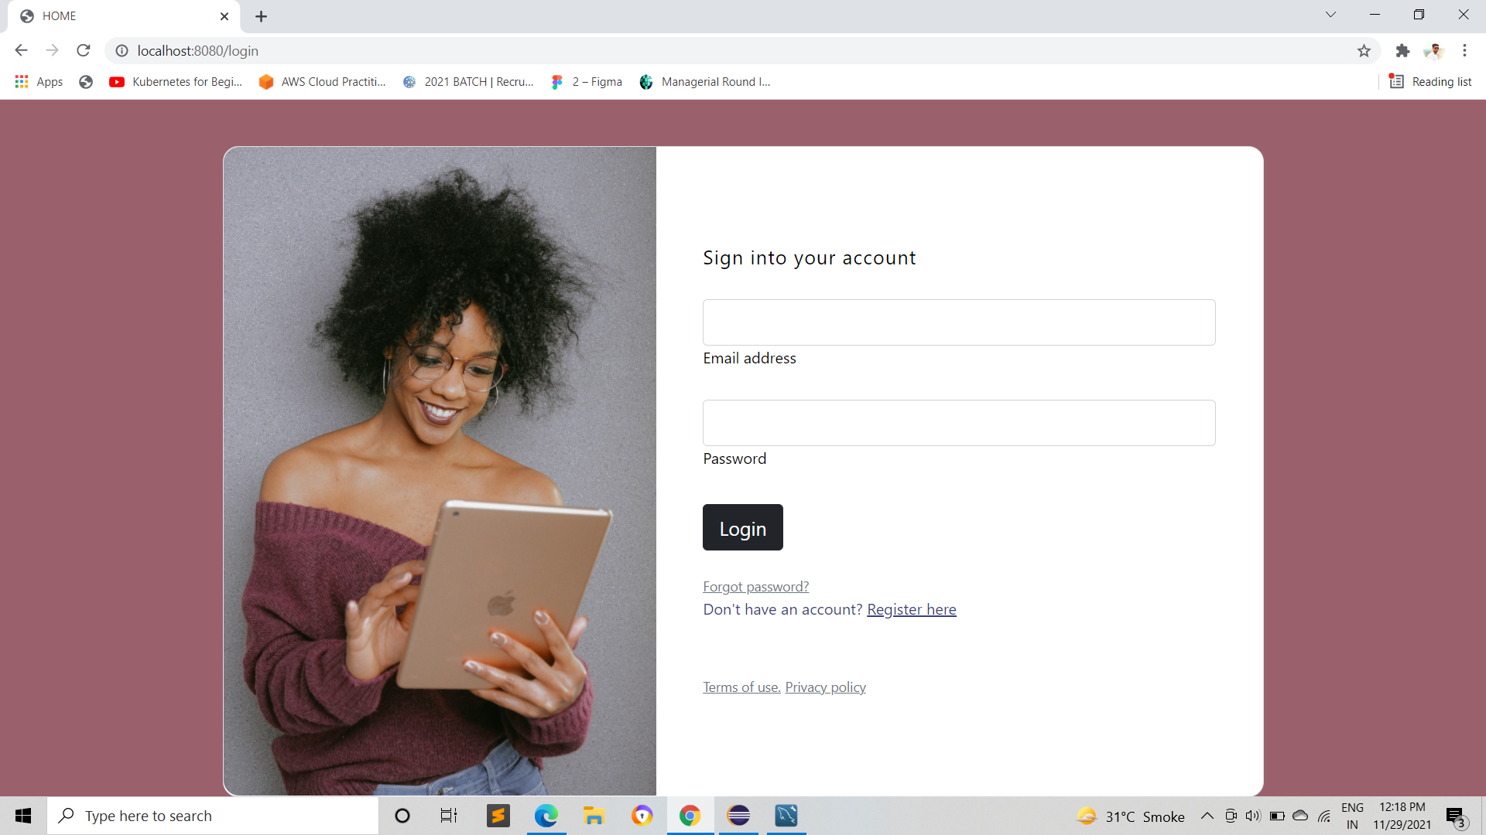

Slide 10
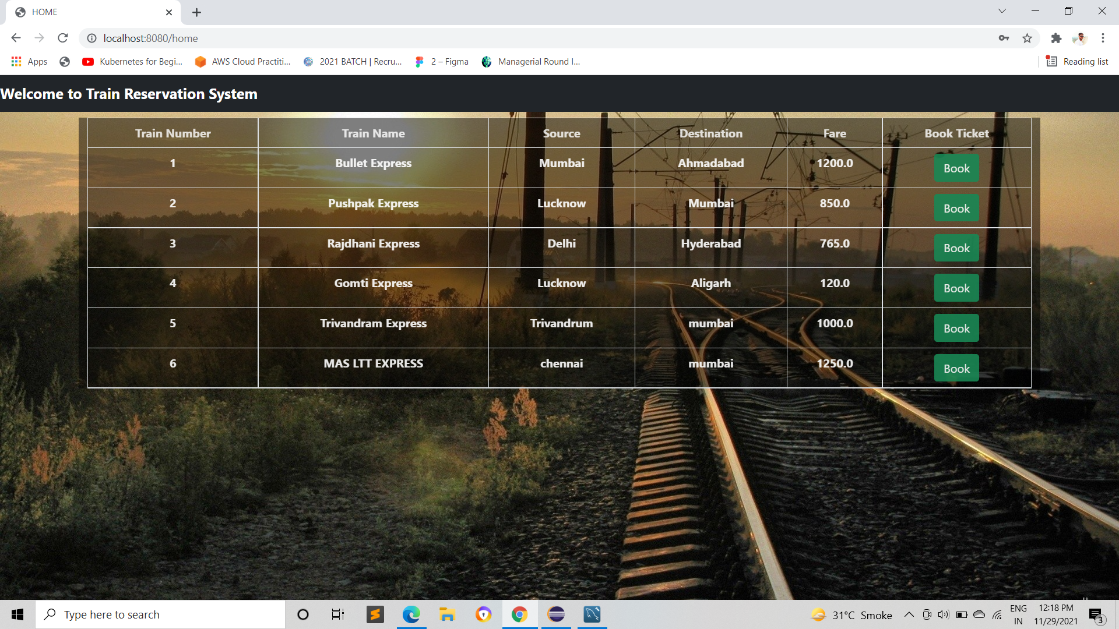

Slide 11

FUTURE SCOPE
Payment Gateway Integration.
Logout Button
Cancel Tickets

Slide 12

THANK YOU

